Slide 1
PRESENTATION ON
FLEX GYM WEBSITE
Presented By: Nikita Gokharkar
Guide: Shalini Kumari
Java Full-Stack Development
Edubridge

Slide 2
CONTENTS
Introduction
About Us
Proposed System
Software Requirements
Screenshots
Conclusion

Slide 3
INRODUCTION TO HTML AND CSS
HTML
HTML: Hyper Text Markup Language.
HTML tags are keywords surrounded by angle brackets like <html>.
HTML documents describe webpages.

Slide 4
CSS
CSS: Cascading Style Sheeet.
CSS is a computer language for laying out and structuring web pages (HTML or XML).
This language contains coding elements and is composed of these “cascading style sheets” which are equally called CSS files

Slide 5
ABOUT WEBSITE
Now a days online service is a best competitve edge for any organization which makes it differ from other organization.
The online gym is a website which provide best platform for ease of access to the customers.
Customers can check the updates online anytime about the services, trainers and membership plans.
Depositing the amount in the Checking Account or Saving Account.

Slide 6
PROJECT GOALS
Provide a platform which will help the user to view all details about the fex gym.
Customer does not need to visit gym physically to enquire about the plans and trainers.
User Friendly.

Slide 7
SOFTWARE REQUIREMENTS
Language - HTML, CSS
IDE - Visual Studio Code

Slide 8

HOME PAGE

Slide 9

ABOUT US

Slide 10
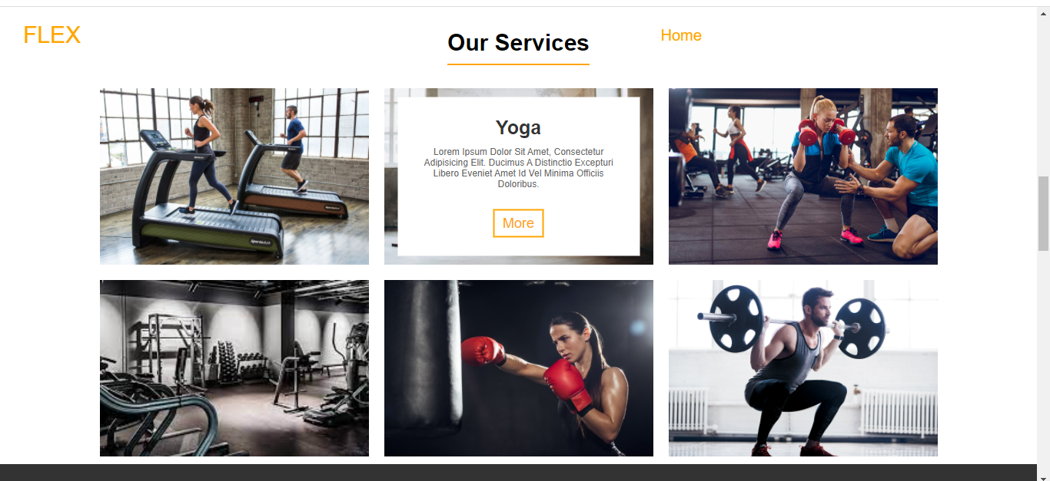
SERVICES PROVIDED

Slide 11
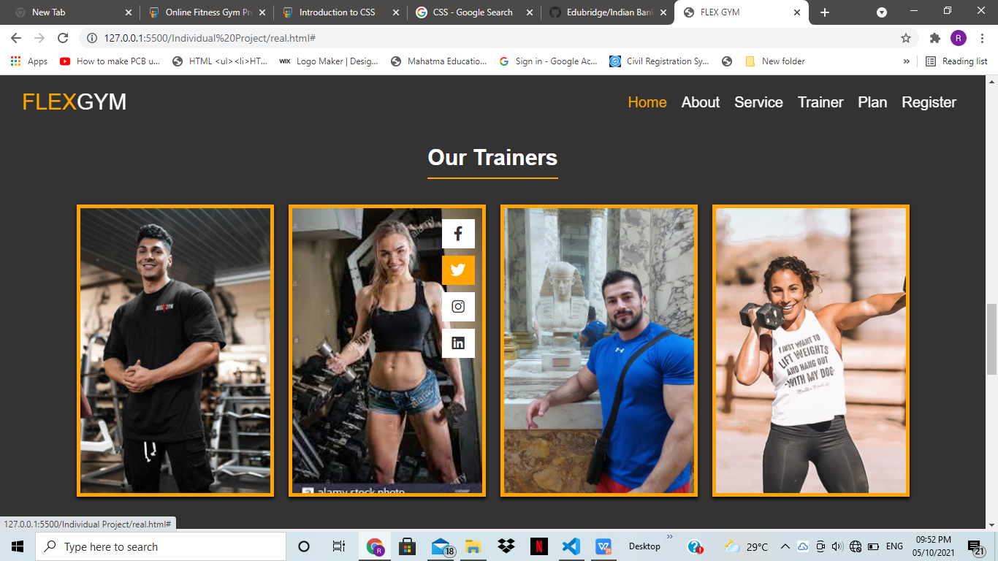
OUR TRAINERS

Slide 12
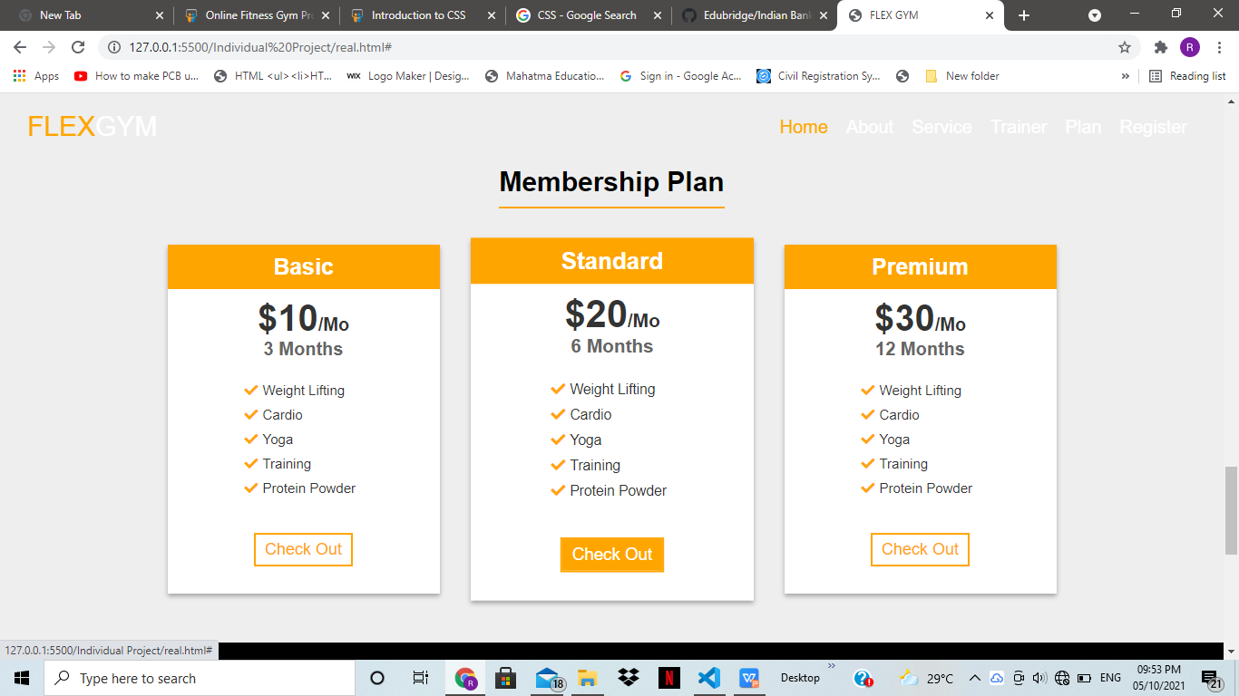
MEMBERSHIP PLANS

Slide 13
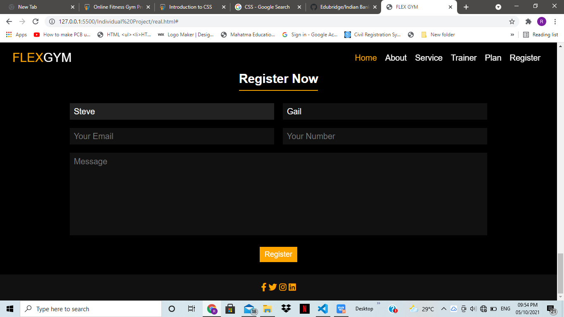
REGISTRATION FORM

Slide 14
CONCLUSION
This system is build to maintaining and managing the details of gym website.

